Slide 1
Finite State Machines
By Ezell Frazier
March 31 2020

Slide 2
September 2019

Slide 3
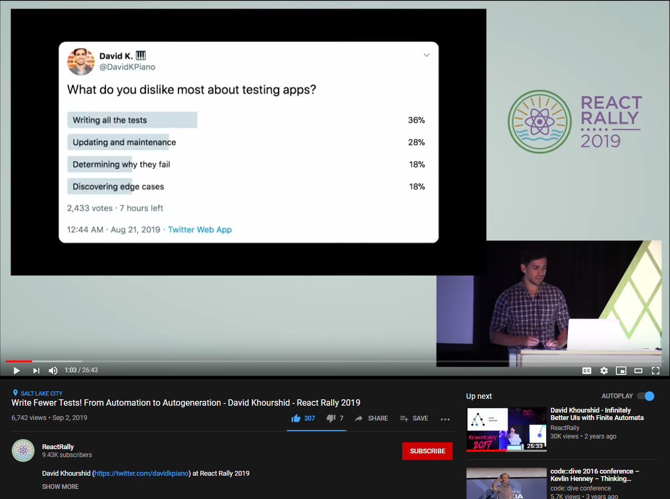
Notes:
It’s funny. My entire presentation today stemmed from learning how to get better at testing. And I found a video, on the surface, which sounds absolutely ridiculous.
Auto-generated tests? What? How?

Slide 4
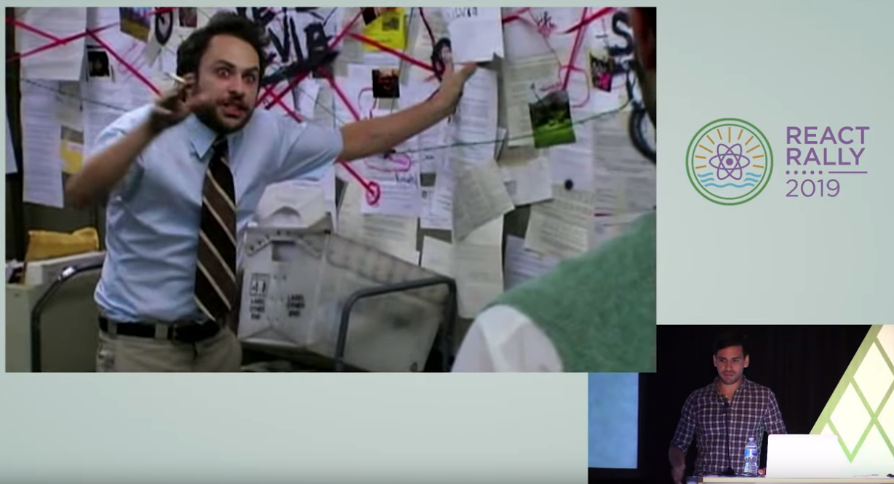
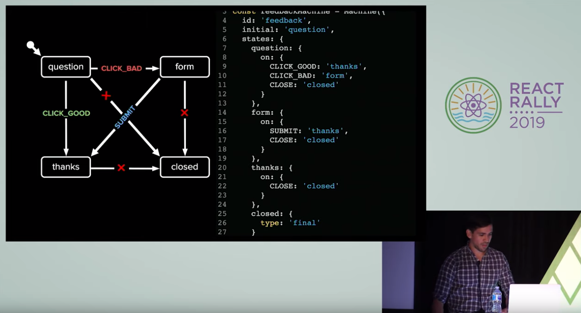
Notes:
Although I enjoyed the presentation, I believe his jokes kept me around more-so than his content.
He went off into the deep end about something called finite state machines.
That was my only take-away from his presentation last summer.

Slide 5
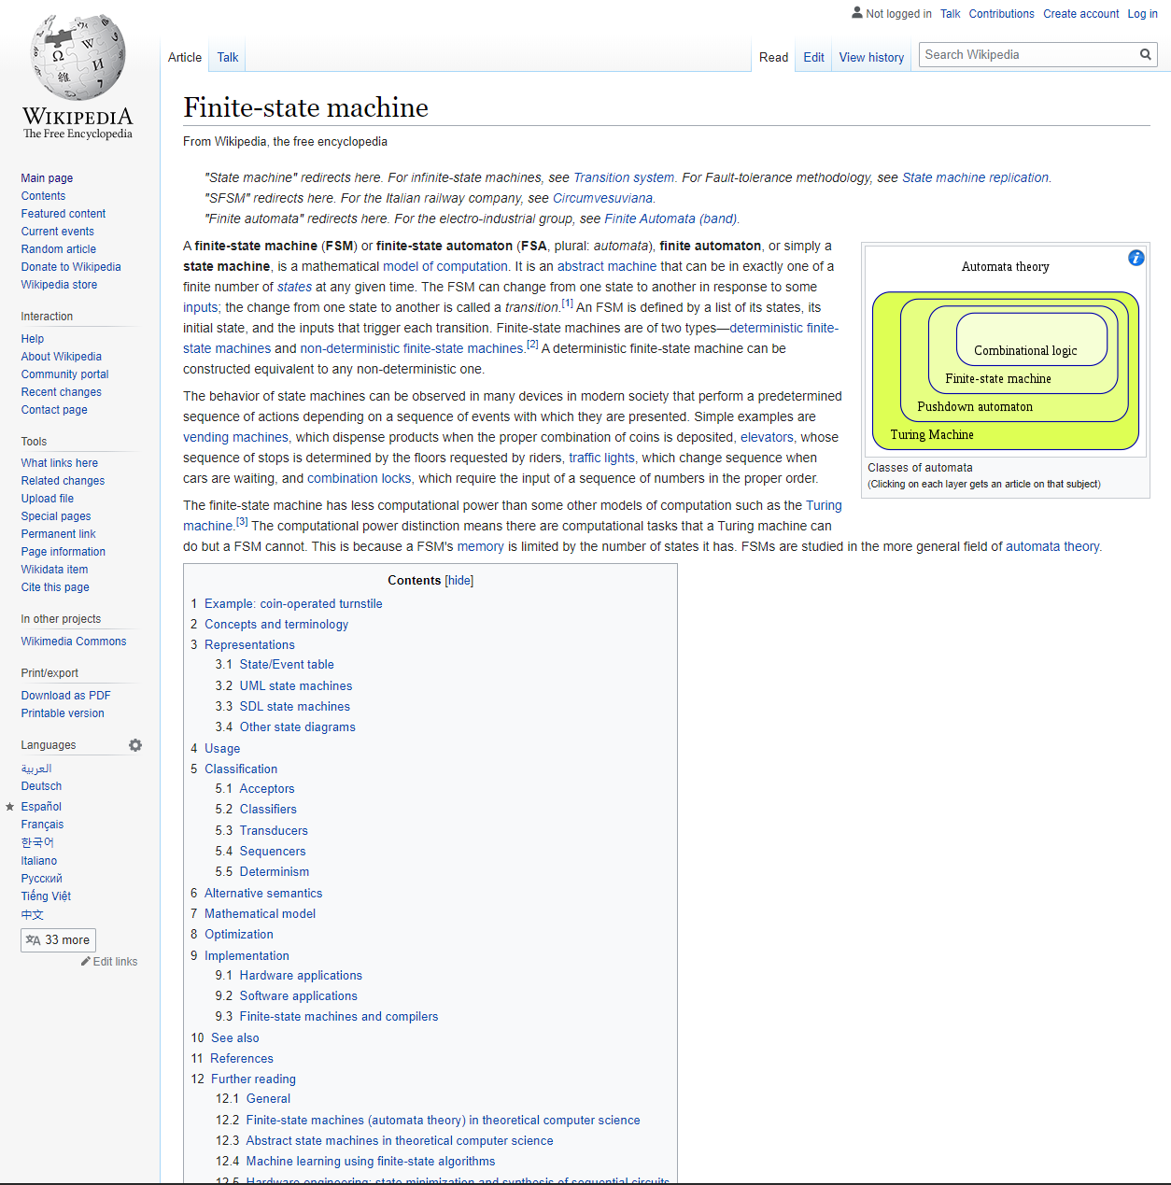



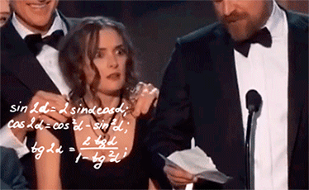
Notes:
What is a finite state machine, and why should I care about it?
So I did what any of us do when presented with a problem.
Google it.
As I read the Wikipedia article, my mind slowly began to disintegrate.
I had to shelve it.

Slide 6
December 2019

Slide 7
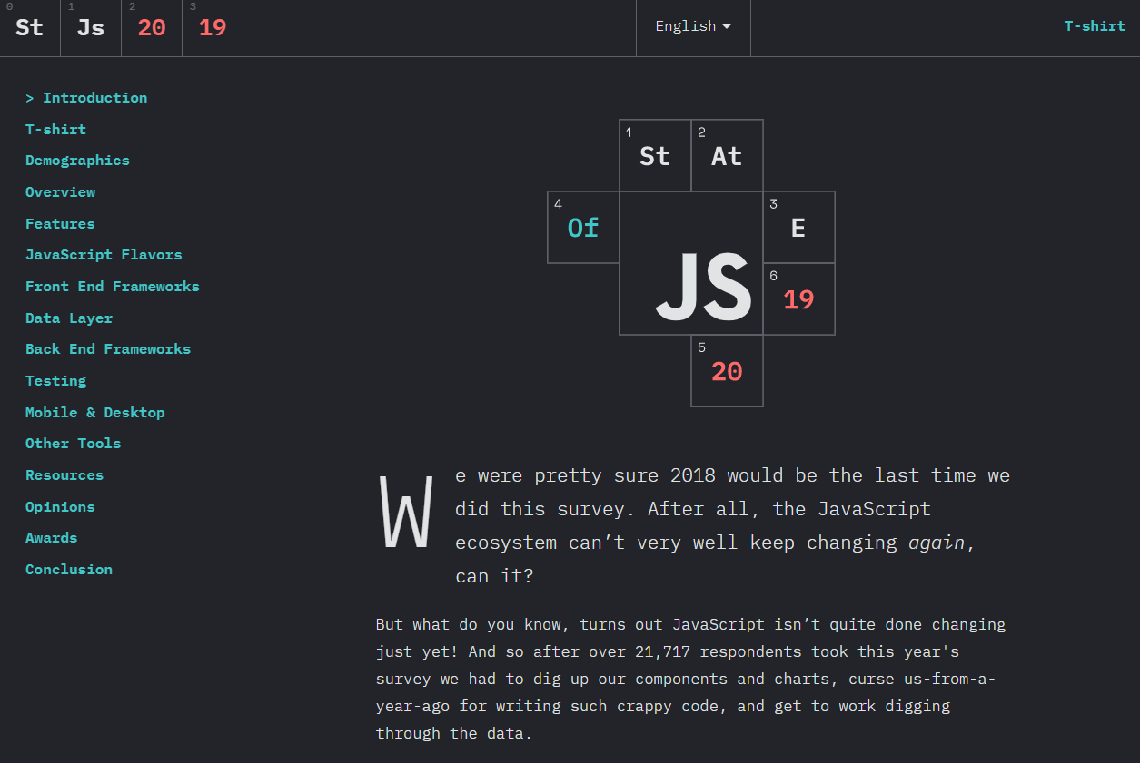
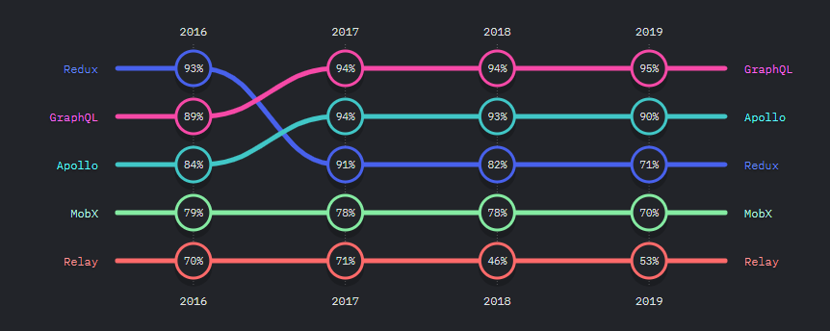
Notes:
Fast forward to December of last year, and we get the results from the annual “State of JS” survey.
You know what caught my eye?
An increasing amount of us aren’t happy with state management.
Redux and MobX’s satisfaction has falled each year.
And Redux continues to stumble down a cliff each year.

Slide 8
Creating reliant, state-driven, applications isn’t hamstrung by a library, but rather, our implementation.

Slide 9
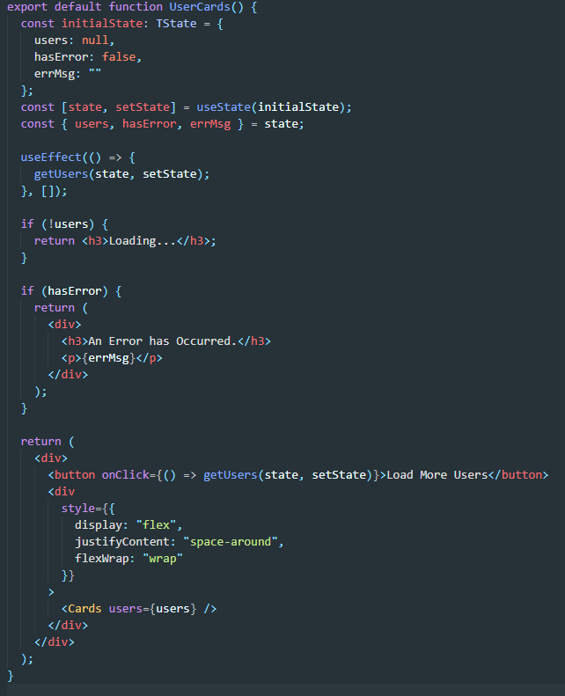

Slide 10
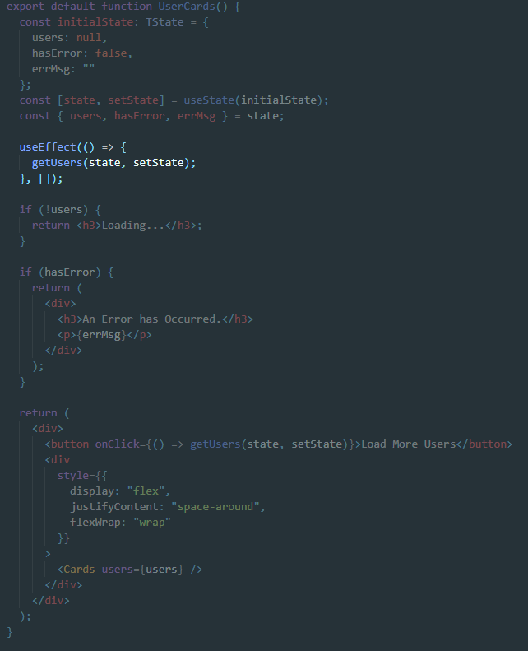

Slide 11
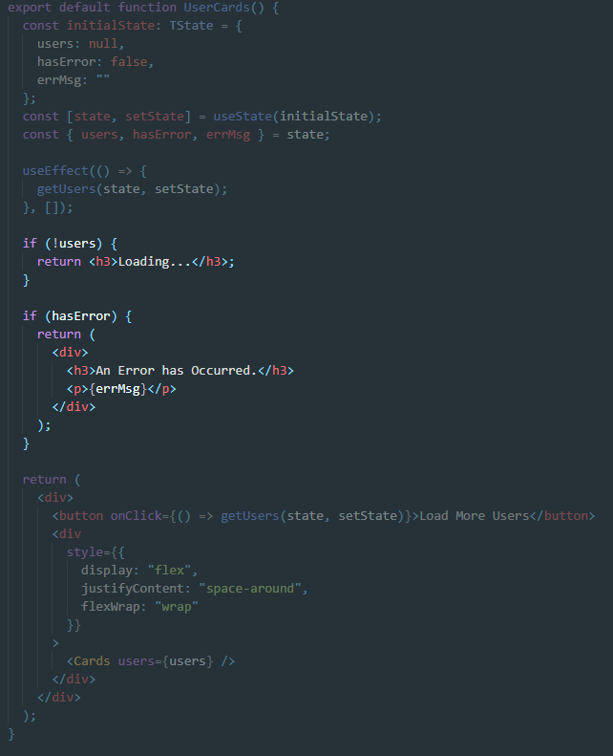
Two “mutually exclusive” states can occur simultaneously

Slide 12
Solution: Add more Boolean checks

Slide 13
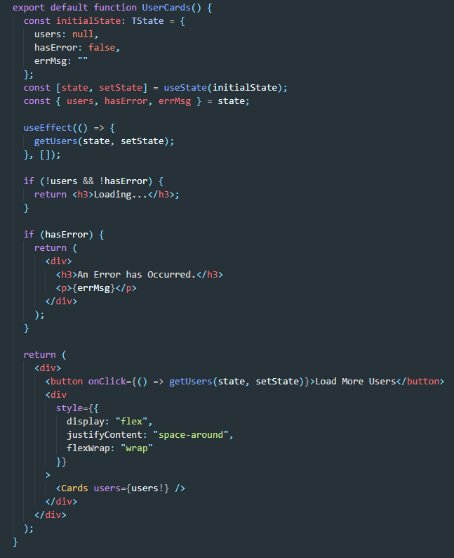

Slide 14
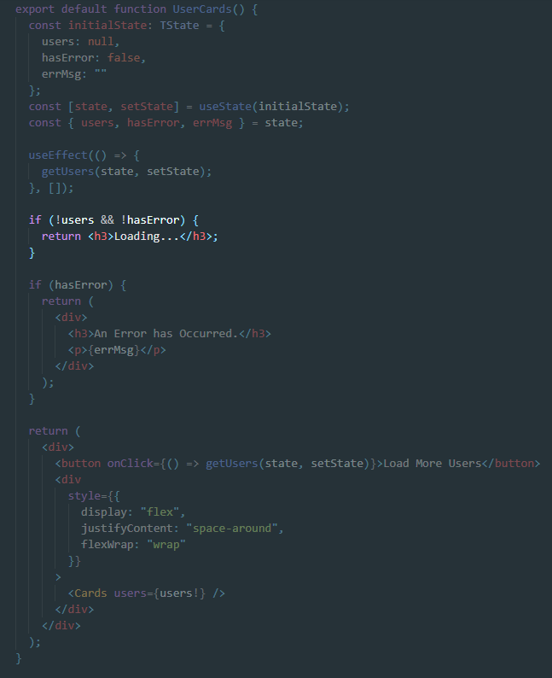

Slide 15
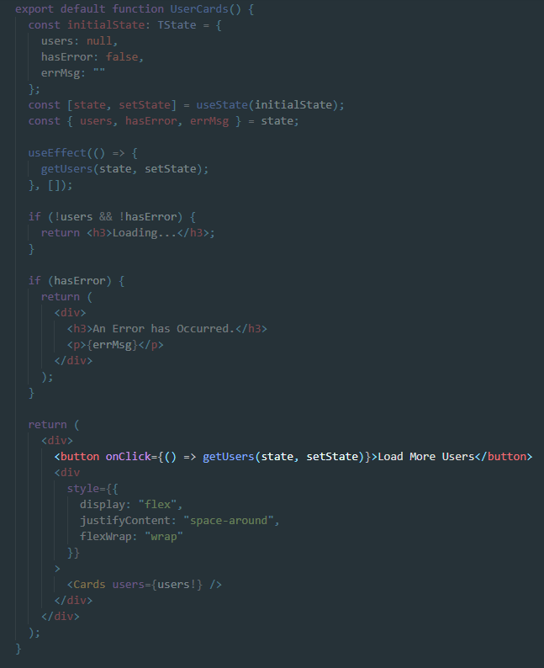

Slide 16
Solution: Add more Boolean checks

Slide 17
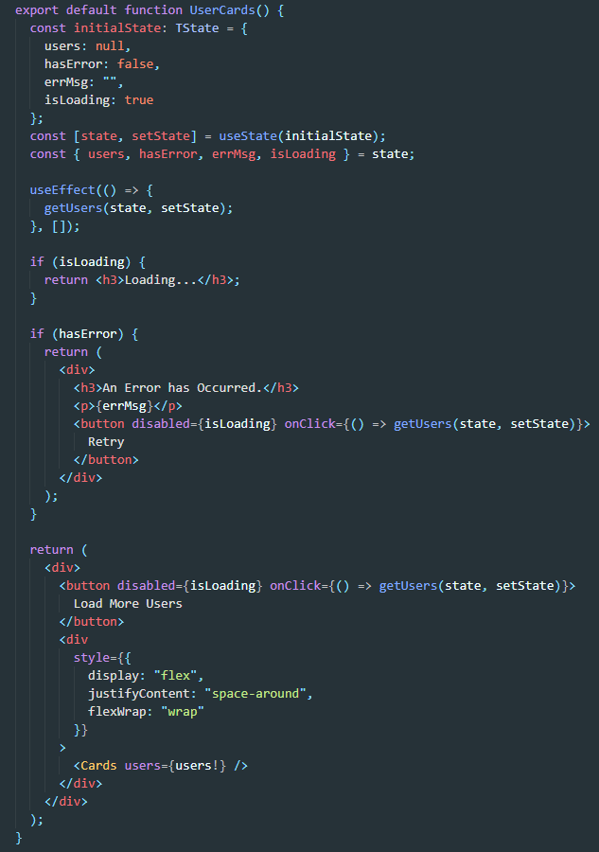

Slide 18
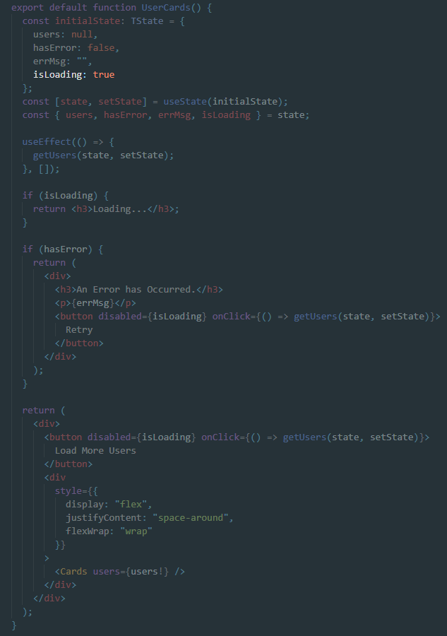

Slide 19
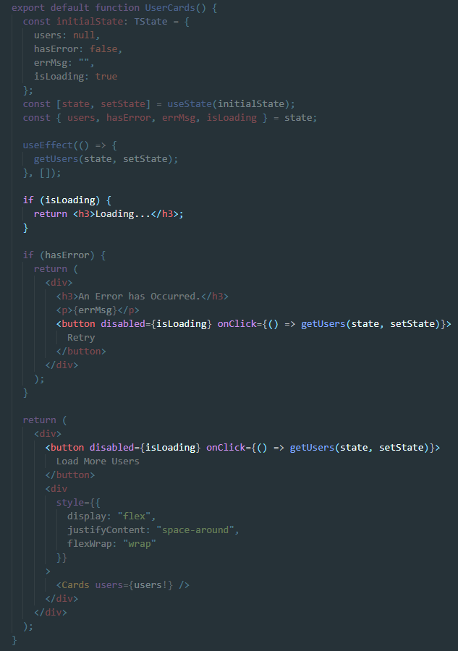

Slide 20
Problem: There were still more edge-cases

Slide 21
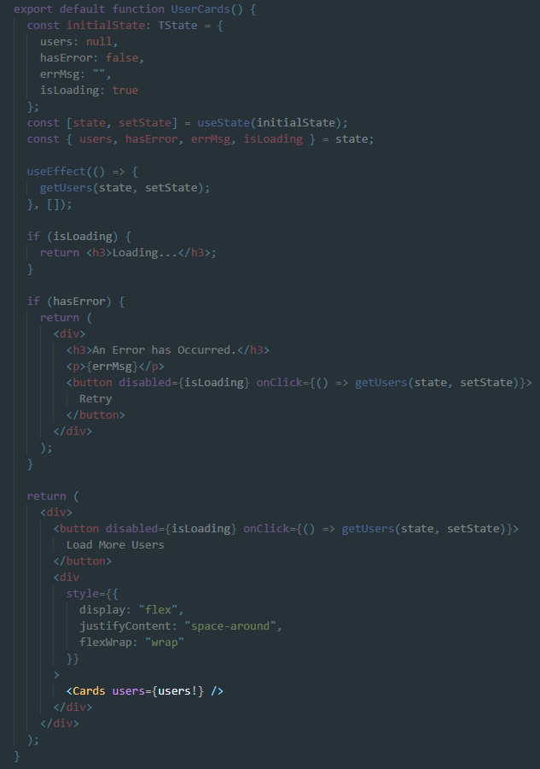

Slide 22
What is a Finite State Machine?

Slide 23
Anything that can be modeled as having a finite number of states is a finite state machine

Slide 24
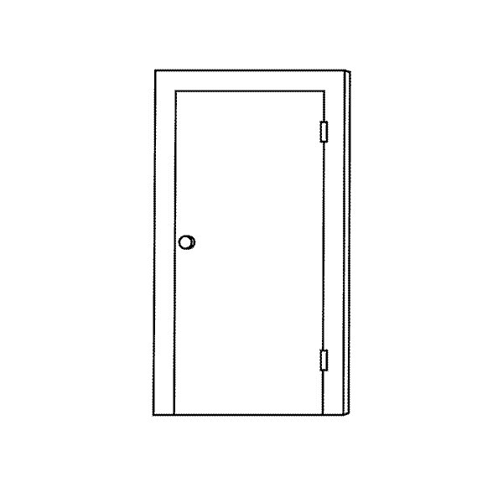
Start State | Event | End State
Open | Open Door | ---
 | Close Door | Closed
Closed | Open Door | Open
 | Close Door | ---

Slide 25
Close Door
Closed
Open
Open Door
Start

Slide 26
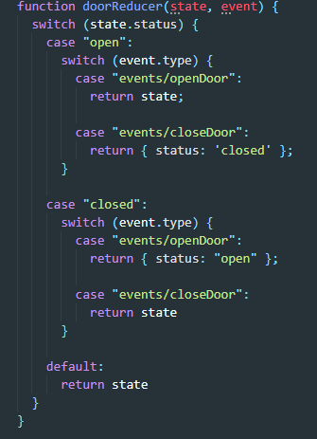

Slide 27
Start State | Event | End State
Open | Close Door | Closed
Closed | Close Door | Closed
Open | Open Door | Open
Closed | Open Door | Open

Slide 28
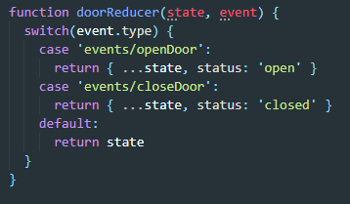

Slide 29
Why would I want to complicate my reducers?

Slide 30
Benefits:
We’re inverting the responsibility of state validation
Views with code which is easier to read and follow
The elimination of potential edge-cases before writing any code

Slide 31
Error
Throw Error
Get Users
Initializing
Fetching
Get Users
Ready
Get Users
Start
Resolve Users

Slide 32
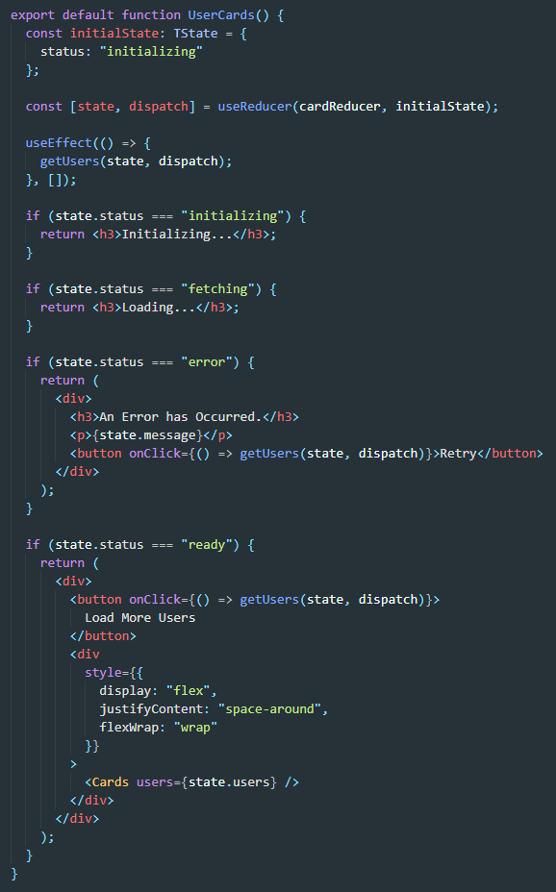

Slide 33
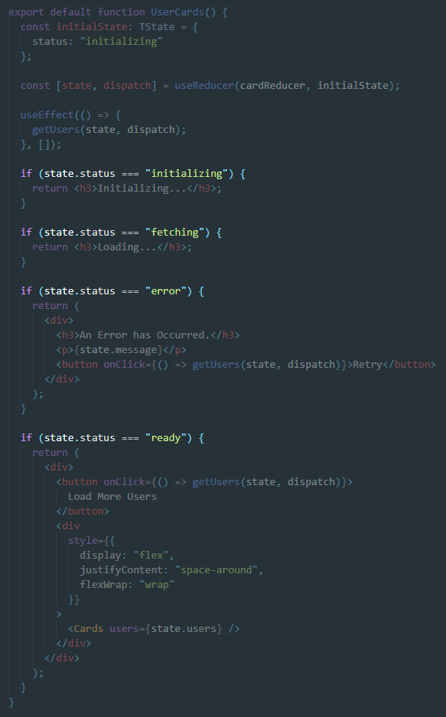

Slide 34
